Slide 1
Angular School
Lesson 6. Redux

Slide 2


Slide 3
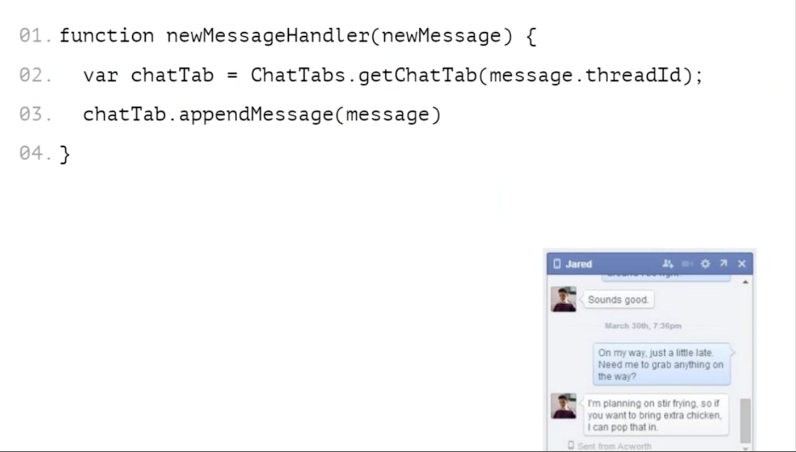
CHAT

Slide 4
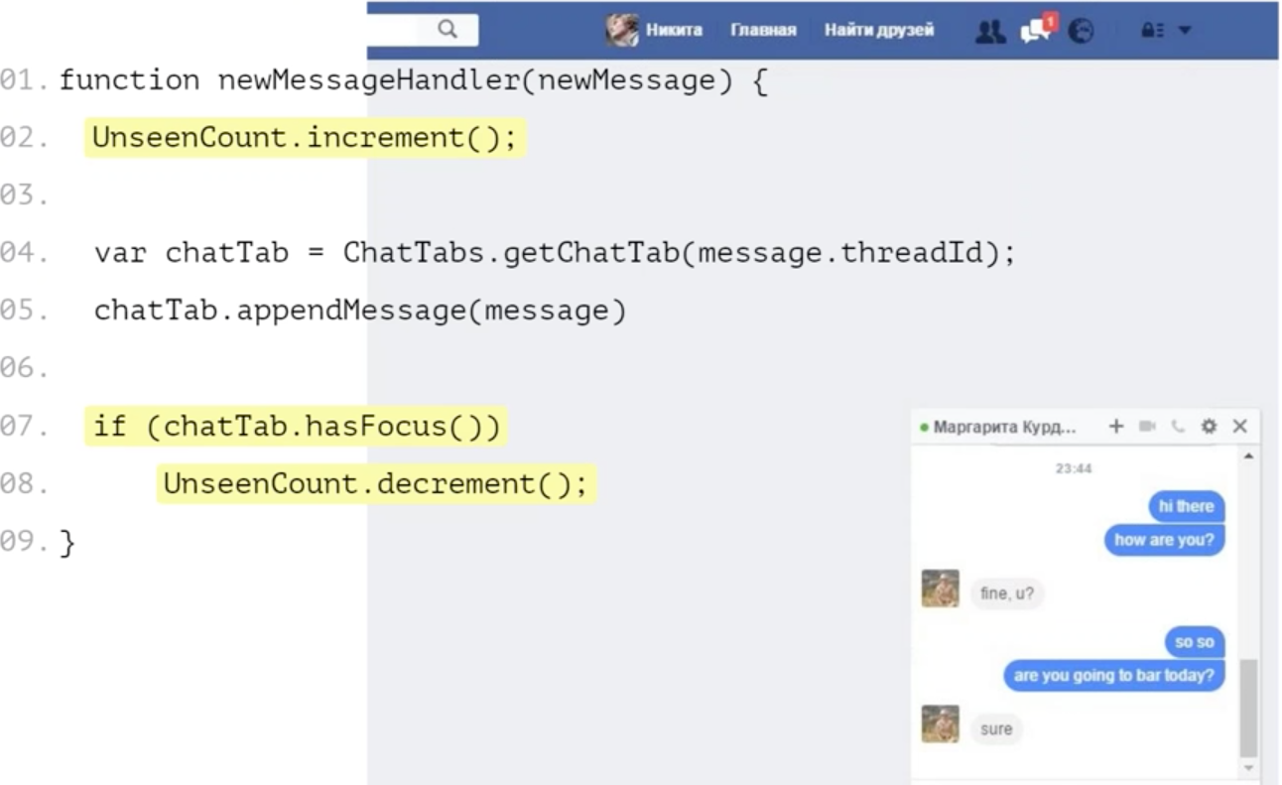
CHAT WITH COUNTER

Slide 5

WHAT ABOUT THIS?

Slide 6
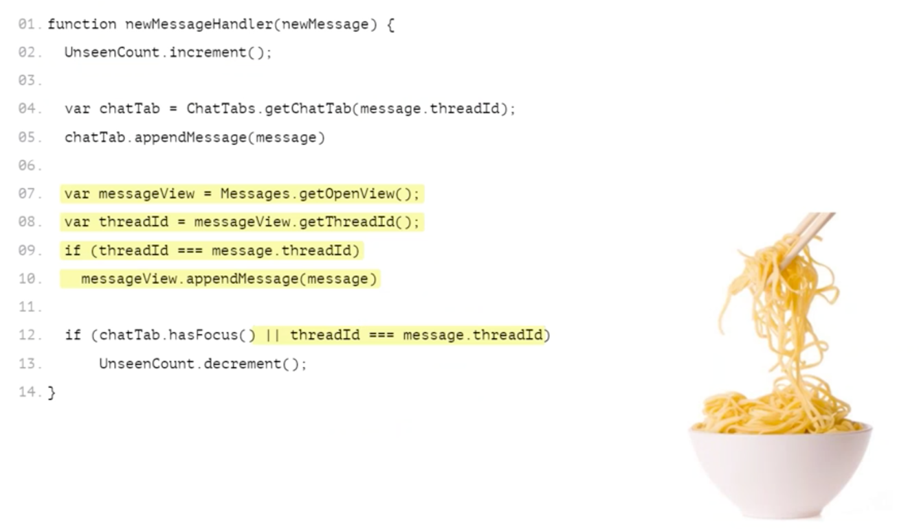
CHAT, THREADS AND COUNTER

Slide 7


Slide 8
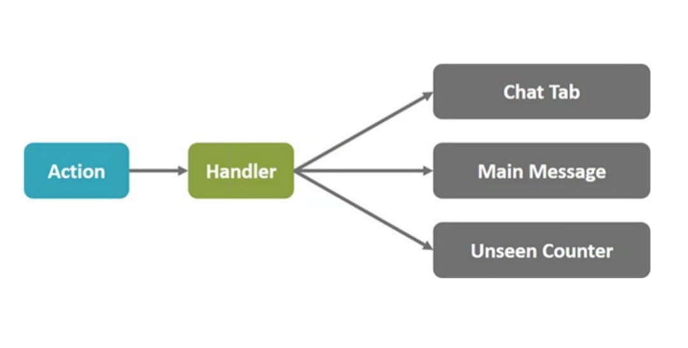
EXTERNAL CONTROL

Slide 9
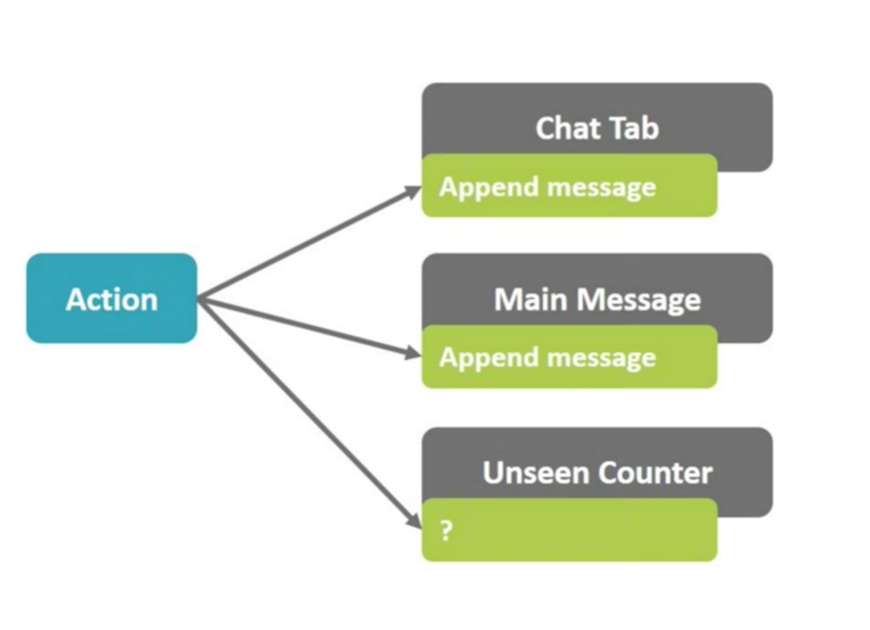
INTERNAL CONTROL

Slide 10
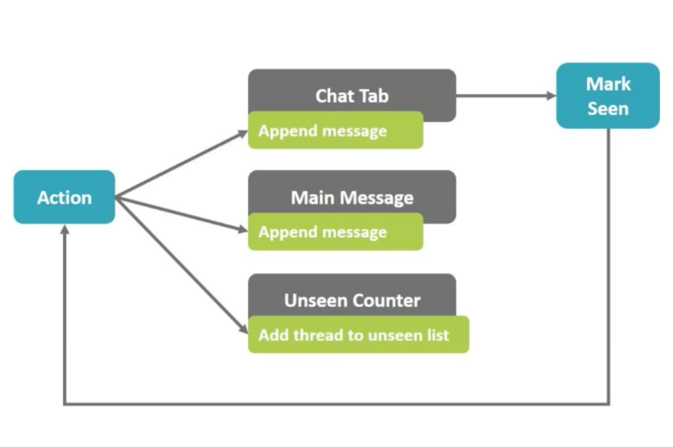
INTERNAL CONTROL: ACTION FLOW

Slide 11
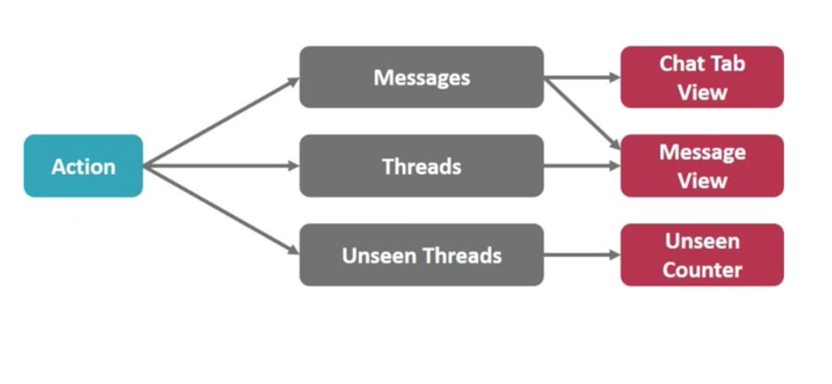
WE ARE GOOD BOYS, WE ARE NOT MIXING VIEW WITH MODEL, AREN’T WE

Slide 12
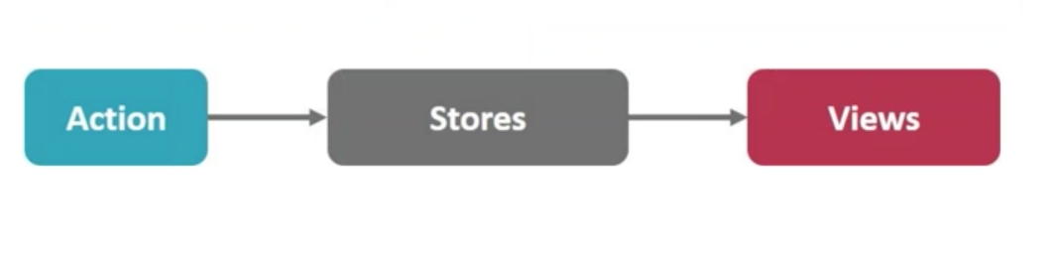
GENERIC SYSTEM

Slide 13
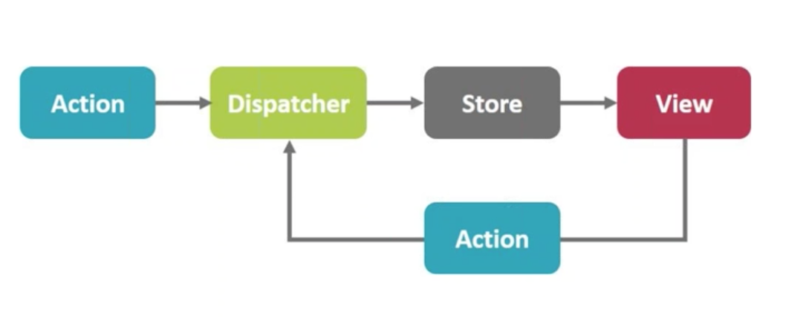
HERE IS FLUX

Slide 14
BENEFITS
Improved data consistency
Easier to pinpoint root of a bug
Easy to test

Slide 15
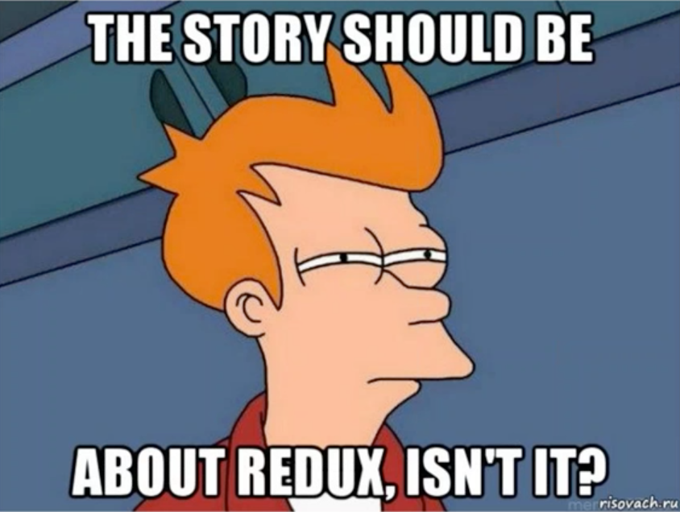

Slide 16
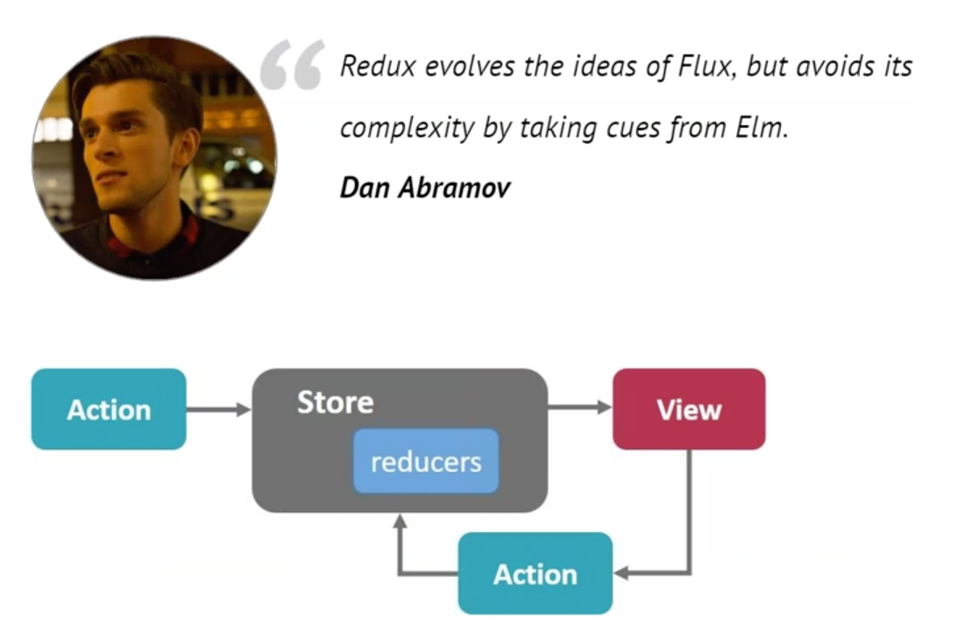
REDUX

Slide 17
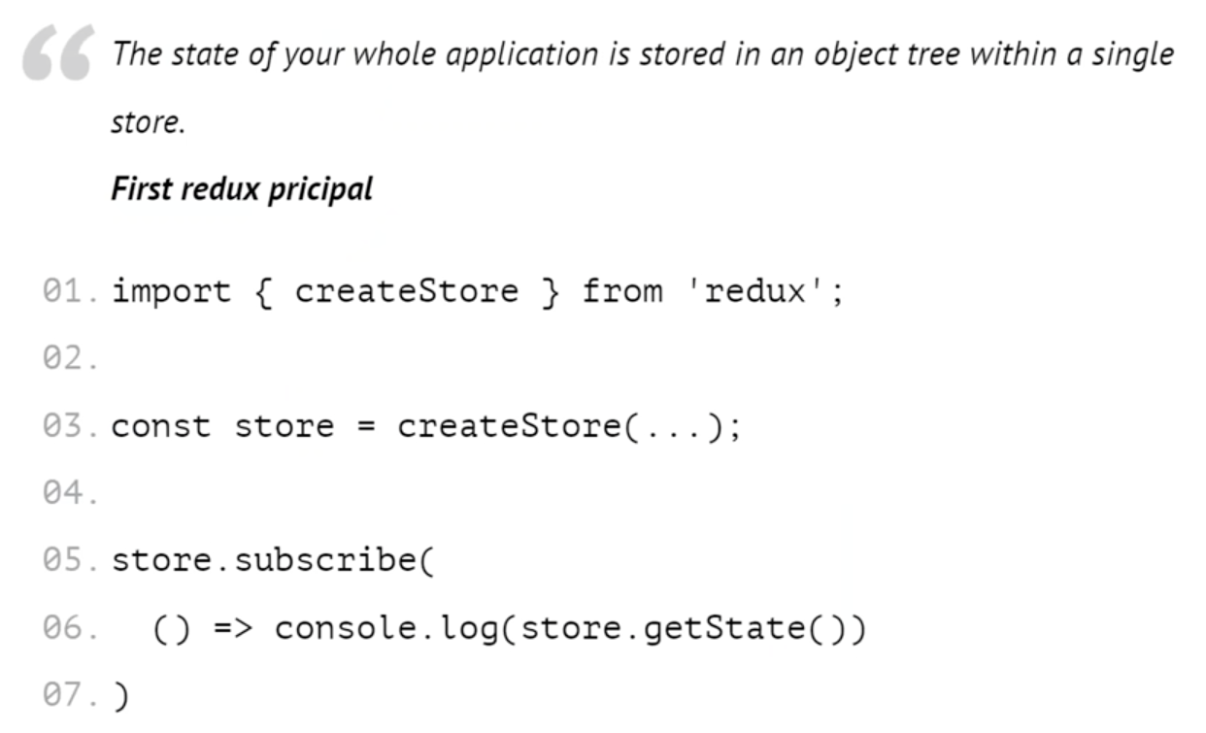
SINGLE SOURCE OF TRUTH

Slide 18
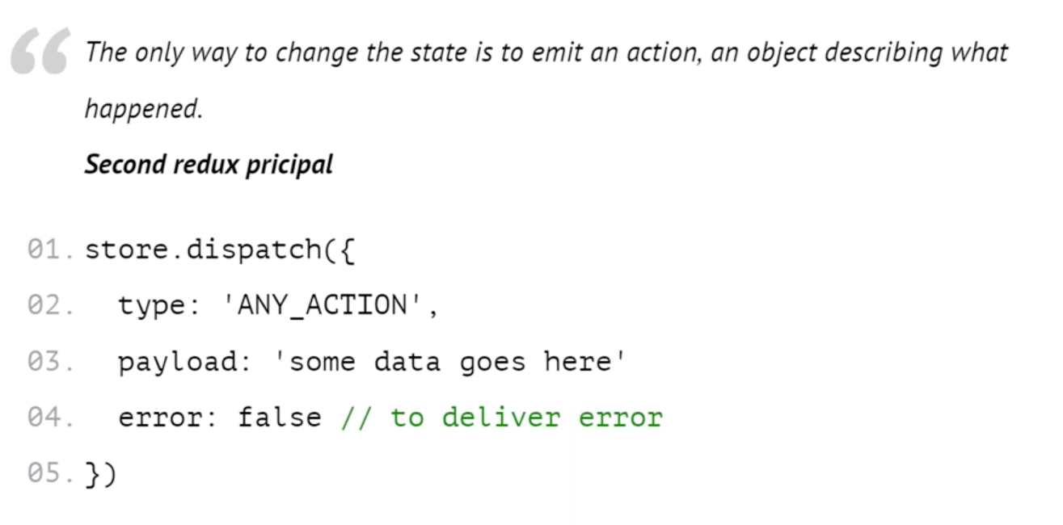
STATE IS READ ONLY

Slide 19
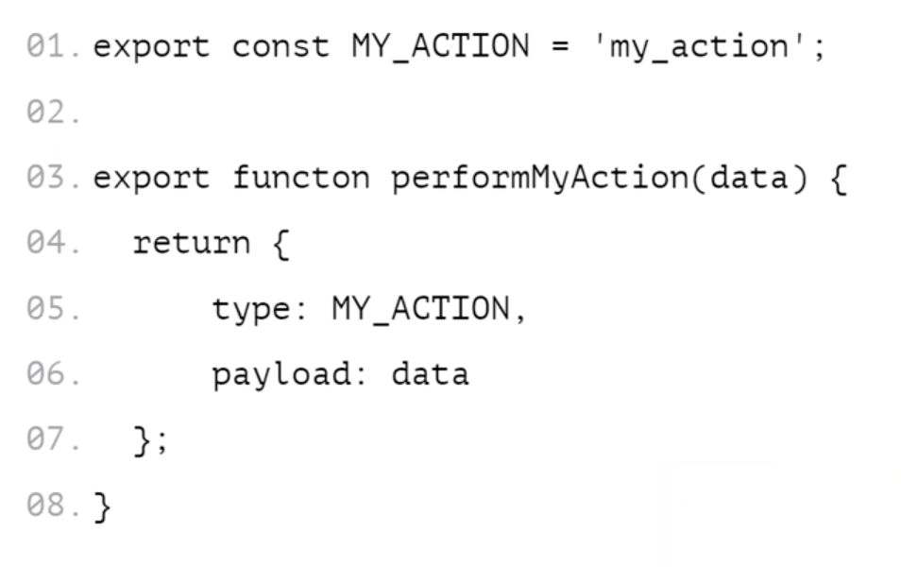
ACTION CREATORS

Slide 20
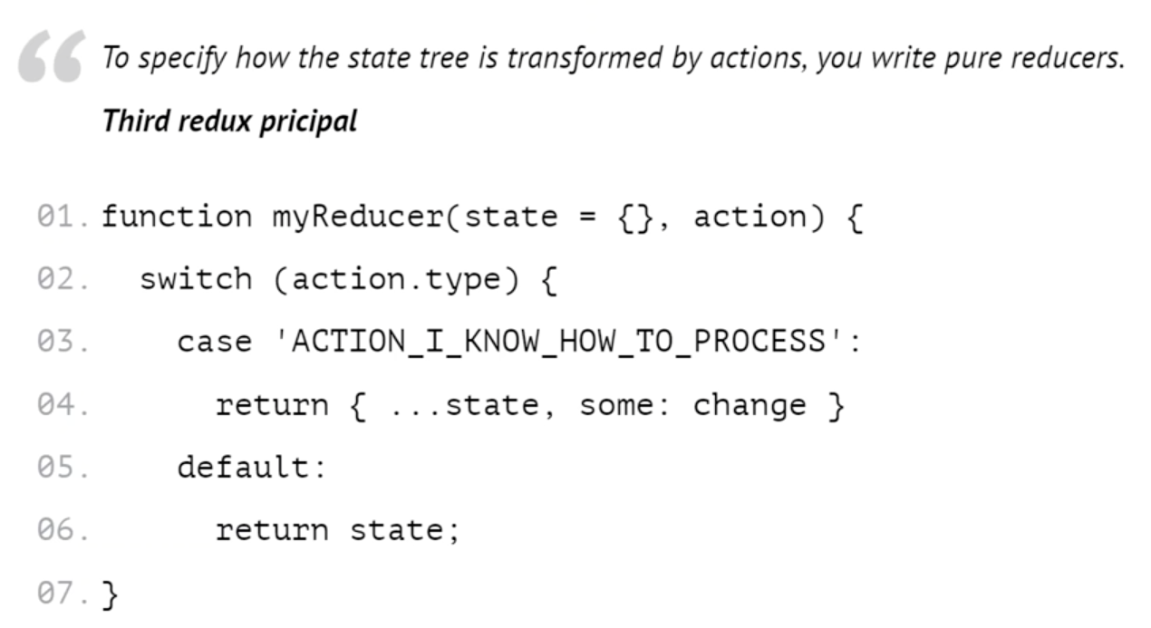
CHANGES ARE MADE WITH PURE FUNCTIONS

Slide 21


Slide 22
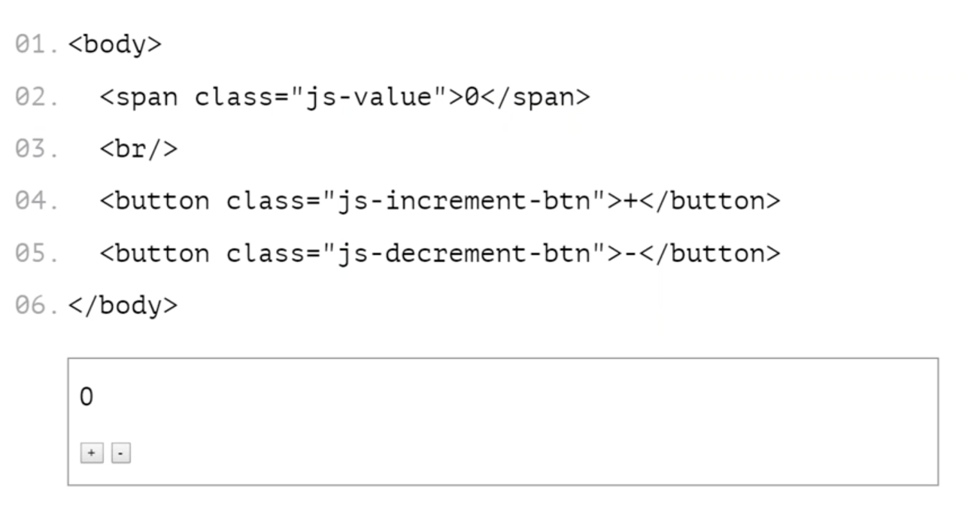
COUNTER APP (MARKUP)

Slide 23
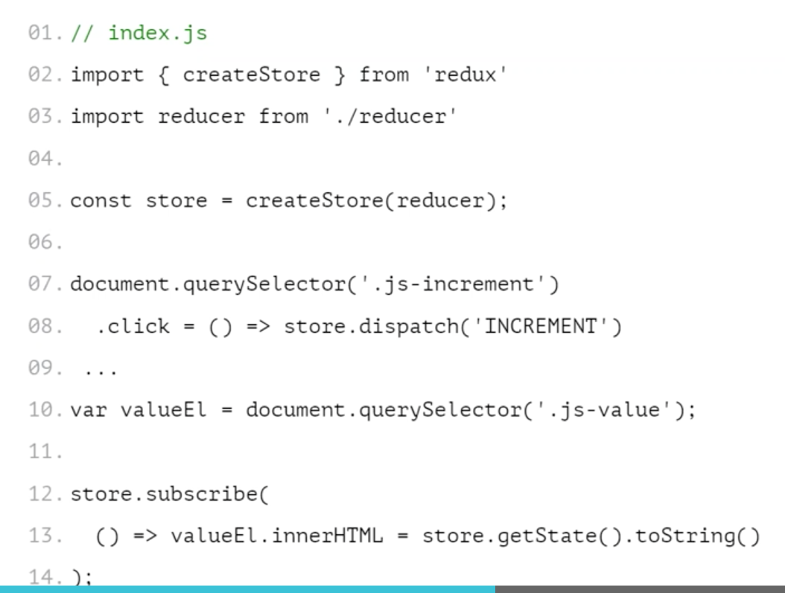
COUNTER APP

Slide 24
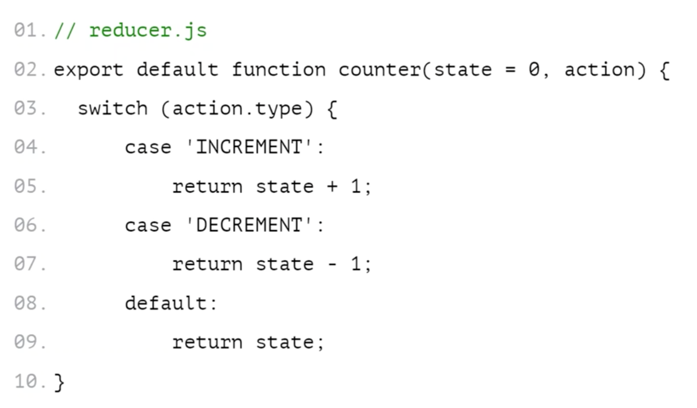
COUNTER APP

Slide 25
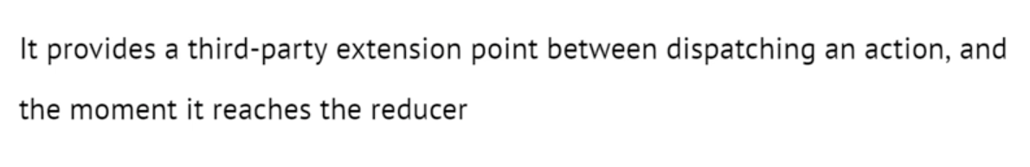
MIDDLEWARE
Logging
Crash reporting
Talking to an asynchronous API
Routing

Slide 26
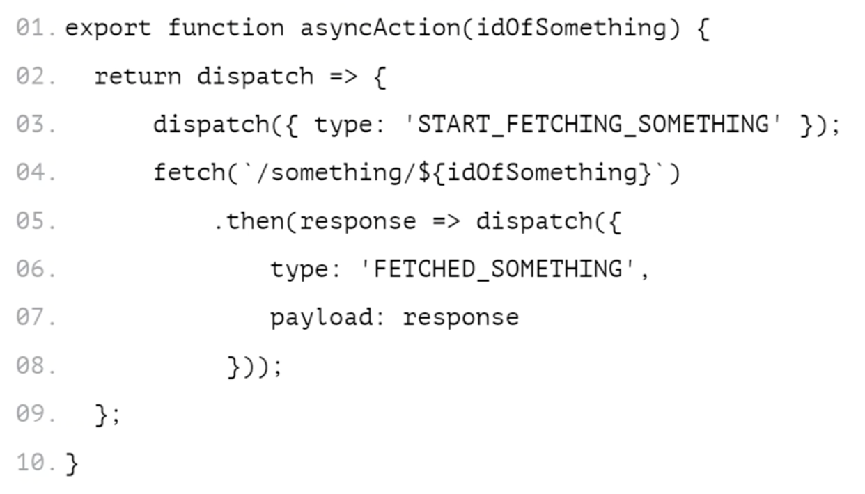
ASYNC ACTIONS

Slide 27
WHY SHOULD I USE REDUX
Flux like solution
It is maintained by facebook
It is tiny (2kB, including dependencies)
Easy to test
Documentation
It has great community
Believe me

Slide 28
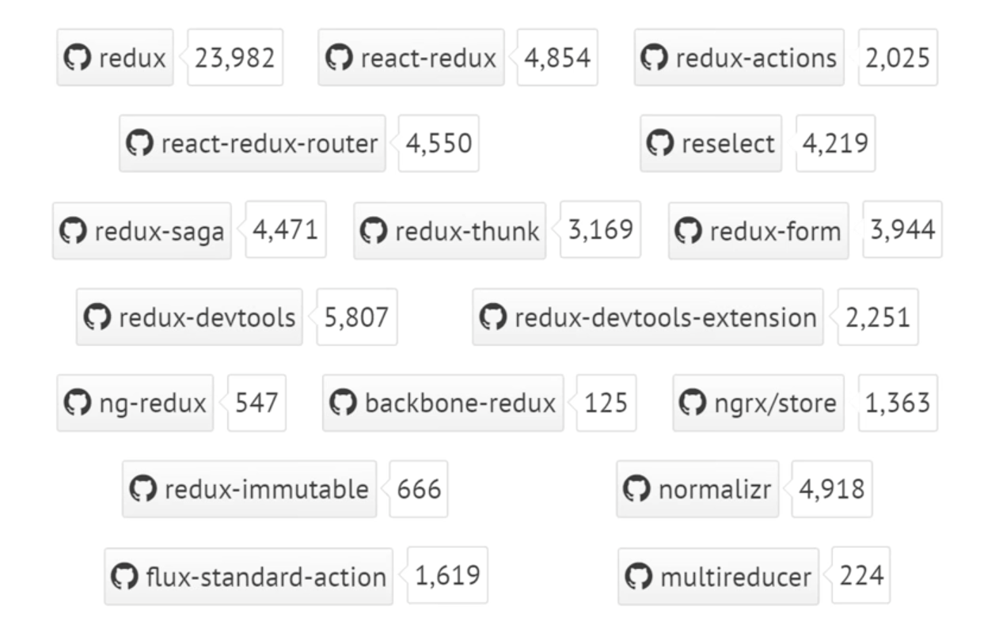
COMMUNITY

Slide 29
Angular School
Thanks!

